Slide 1
DIABETES PREDICTION
USING DATA SCIENCE AND MACHINE LEARNING

Slide 2
Abstract
Diabetes is a chronic disease that can cause a worldwide healthcare crisis
. According to International Diabetes Federation 382 million people are living with diabetes worldwide. By 2035 this will be doubled to 592 million.
. However, early prediction of diabetes is quite a challenging task for medical practitioners due to the complex interdependence on various factors
Machine Learning is an emerging scientific field in data science dealing with how machines learn from experience
The project aims to predict diabetes via logistic regression, Support Vector Machine, Naïve Bayes, KNN algorithms

Slide 3
Content
Introduction
Existing Method
Proposed method with Architecture
Methodology
Implementation
Conclusion

Slide 4
Introduction
Diabetes is the most common disease worldwide and keeps increasing daily due to changing lifestyles, unhealthy food habits, and overweight problems.
There were studies handled in predicting diabetes through physical and chemical tests available for diagnosing diabetes.
Data Science methods have the potential to benefit other scientific fields by shedding new light on common questions.
In the proposed system, an efficient way of detecting diabetes is proposed through ML under I used several classification algo such as Logistics Regression, etc. algorithm
The experiment result shows that the prediction of diabetes is done with high accuracy.

Slide 5
Existing System
Existing research handled for diabetes detection. Data mining approaches like clustering, and classification were studied in existing systems.
Diabetes prediction using k- Nearest Neighbors, K-mean, branch, and bound algorithm was proposed. A basic diabetic dataset is chosen for carrying out the comparative analysis. The importance of feature analysis for predicting diabetes using machine learning techniques is discussed.
This is proposed to be achieved through a machine learning Logistics Regression Support Vector Machine, Naïve Bayes, and KNN Algorithm.
The system improves the accuracy of prediction through machine learning techniques.

Slide 6
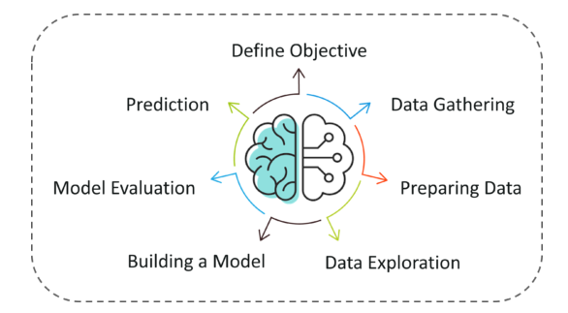
Methodology

Slide 7
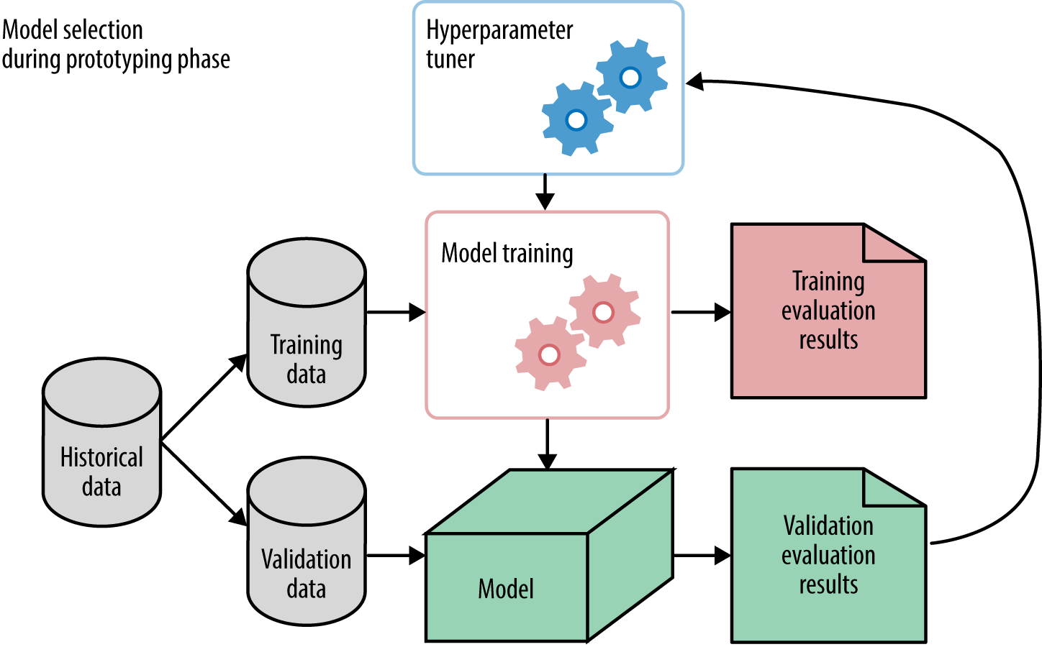
Splitting The Dataset

Slide 8
Implementation
We will test the Machine Learning model using Logistics Regression and compare their accuracy in this part. We will use sklearn. preprocessing to convert the data into quantiles before dividing the dataset.
We first have to import the most popular Python libraries, which we will use for implementing machine learning algorithms in the first step of building the project, including Pandas, Seaborn, Matplotlib, and others.
I will use Python because it is the most adaptable and powerful programming language for data analysis. In the world of software development, we also use Python.

Slide 9
Data Splitting
I will now divide the data into a training and testing dataset. We will use the training and testing datasets to train and evaluate different models. We will also perform cross-validation for multiple models before predicting the testing data.
I split the dataset into the train (70%) and test (30%) datasets
A list of machine learning models is passed to the 'model' function, which provides a graph of the cross-validation scores based on the mean accuracy values of various models supplied to the function.
we have discovered that the Logistic Regression, models have higher accuracy.

Slide 10
Conclusion
As per The main objective of the project is to predict and identify Diabetes patients using Machine Learning Algorithm
is being discussed throughout the project.
I build a model using a Logistic regression machine learning algorithm. It is a supervised machine-learning algorithm.
As a part of the future scope, I hope to try out ML algorithms to optimize the feature output process, increase
the feature similarity of data to improve the model’s representation capability

